Slide 1

Cancer Detection via
Deep Learning
Analyzed by : Thomas Sigmund December 2024

Slide 2
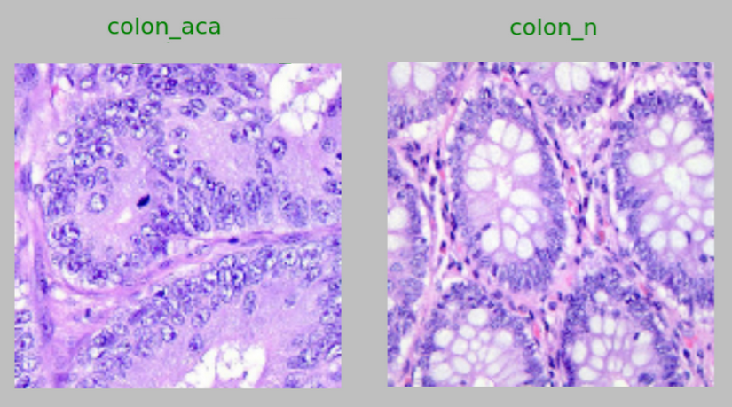
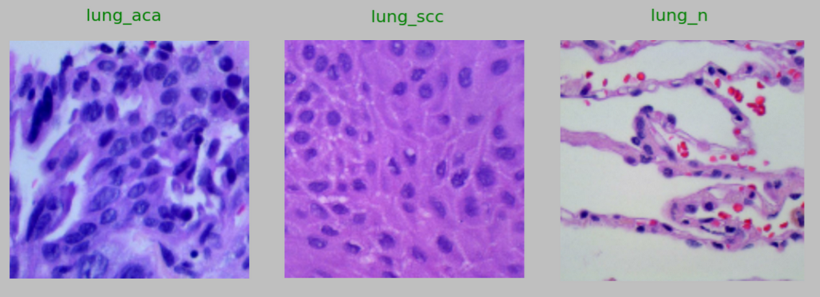
Analysis Data
Histopathological Images
Lung tissue
Adenocarcinoma (ACA)
Squamous Cell Carcinoma (SCC)
Benign
Colon tissue
Adenocarcinoma (ACA)
Benign

Slide 3
Key Objectives
Questions to answer
Is this a cancerous tissue sample?
What type of cancer is it?
Generate the algorithm
Deep Learning using Convolutional Neural Networks (CNNs)
Tools to support Medical Doctors
Cancer Detection via Medical Apps
Commitment to Ongoing Improvement
Improve Algorithm
Extending Analysis to Various Cancer Types

Slide 4
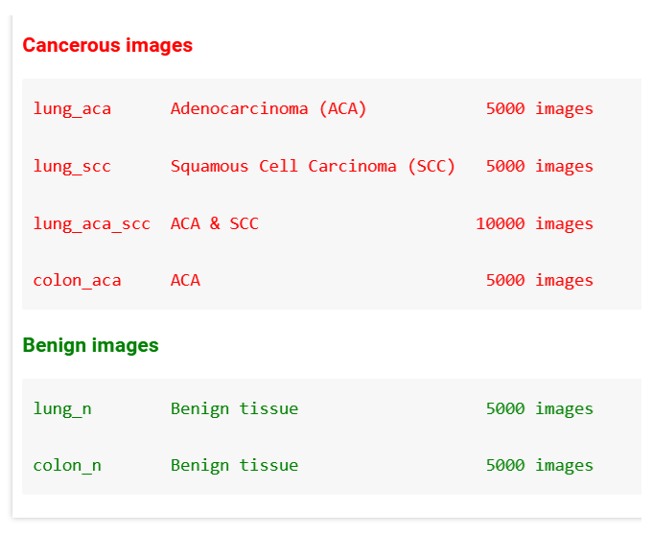
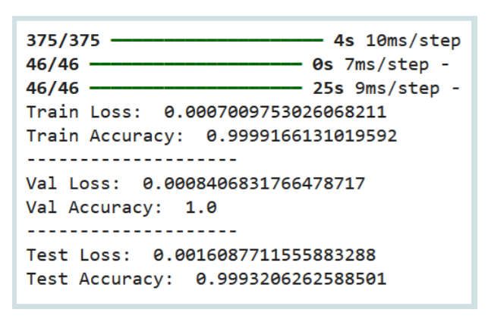
Evaluation
Data Sets
Loss / Accuracy

Slide 5
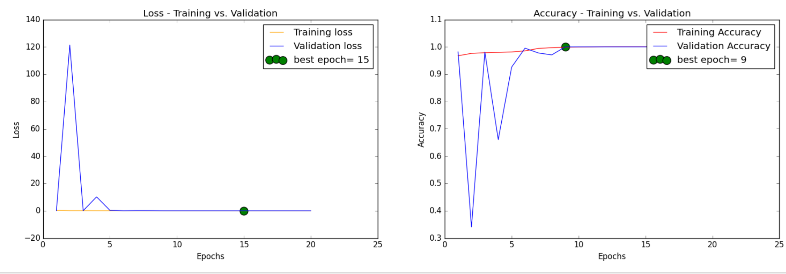
Model Performance
Loss
Accuracy

Slide 6
Cancer Detection - Tools
Five Analysis Scenarios
Lung Tissue Classification
Cancer aca & scc vs. benign tissue
Cancer aca vs. benign tissue
Cancer scc vs. benign tissue
Cancer aca vs. scc
Colon Tissue Classification
Cancer aca vs. benign tissue

Slide 7
Insights
Supporting Diagnosis Process
Timely Diagnosis
Assisting Medical Doctors in Stressful Daily Routines
Reducing Human Error: A Second Opinion Backup
Conclusions from Results
Prioritize potentially cancerous samples
Identify the type of cancer
Faster initiation of cancer treatment
Reliability
High Accuracy Rate Leading to Correct Predictions

Slide 8
Next Steps
Improve Algorithm
Extending Analysis to Various Cancer Types
Analyze Multiple Images
Robustness with Variable Image Sizes

Slide 9
Final Thoughts
Fascinating World of Deep Learning
Especially Convolutional Neural Networks
Promising Future for Model Improvement
Improved CNN Algorithms and More Powerful Computing Resources
Helpful Tools
Assisting Medical Doctors in Stressful Daily Routines
But they are still tools - "the doctor has the final say."

Slide 10
Cancer Detection via
Deep Learning
Thank you :)
Analyzed by : Thomas Sigmund December 2024

Slide 12
Cancer Detection via
Deep Learning
Behind the scenes …
Analyzed by : Thomas Sigmund December 2024

Slide 13
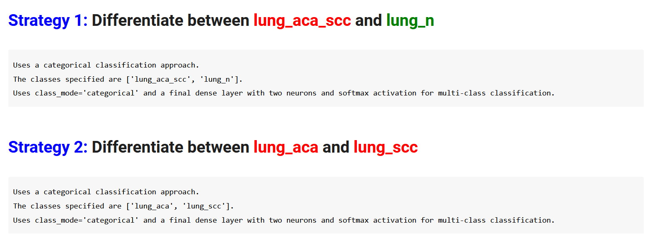

Slide 14
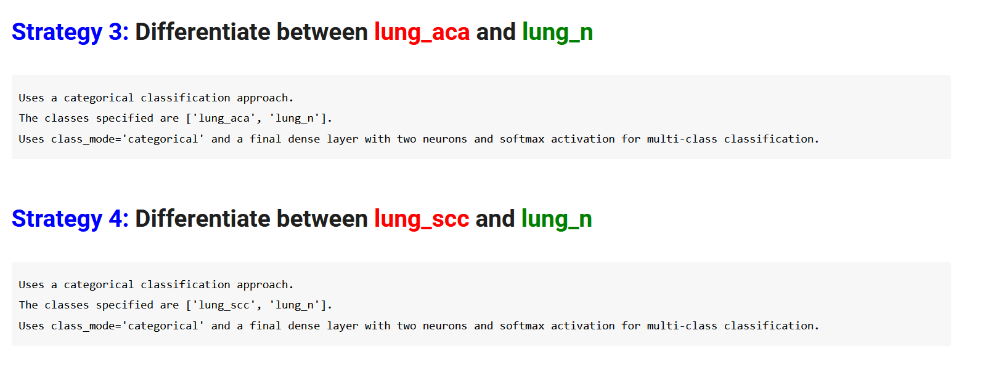
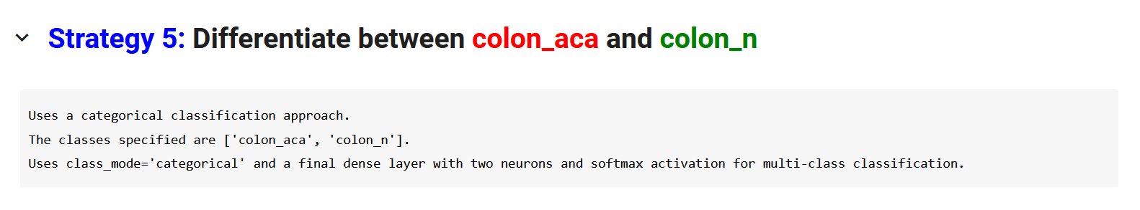

Slide 15
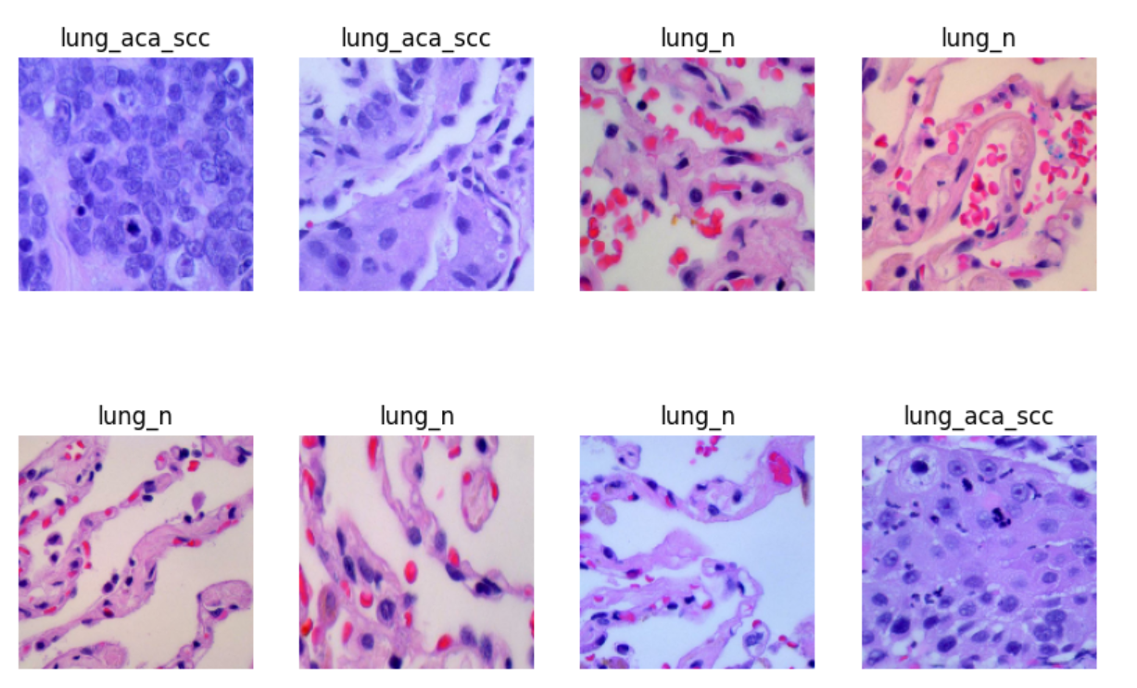

Slide 16
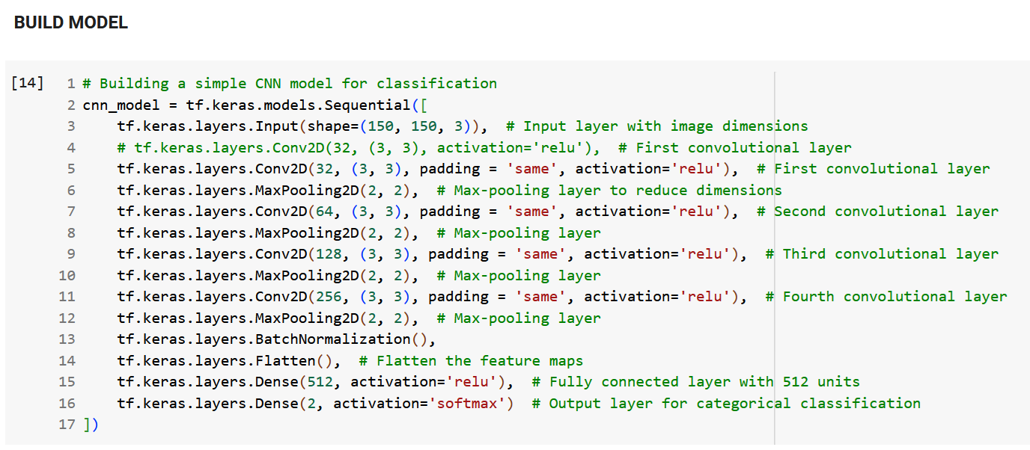

Slide 17
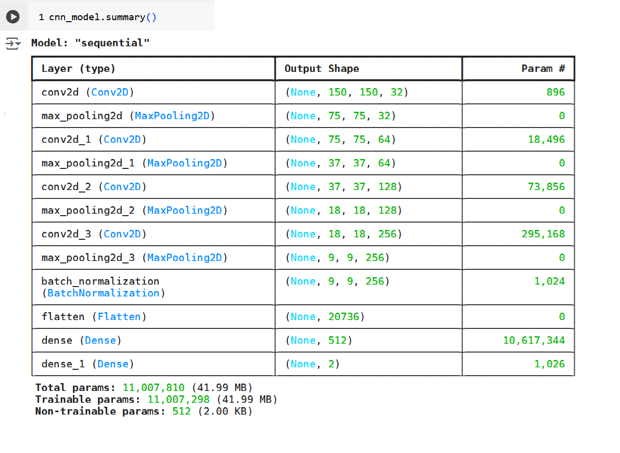

Slide 18
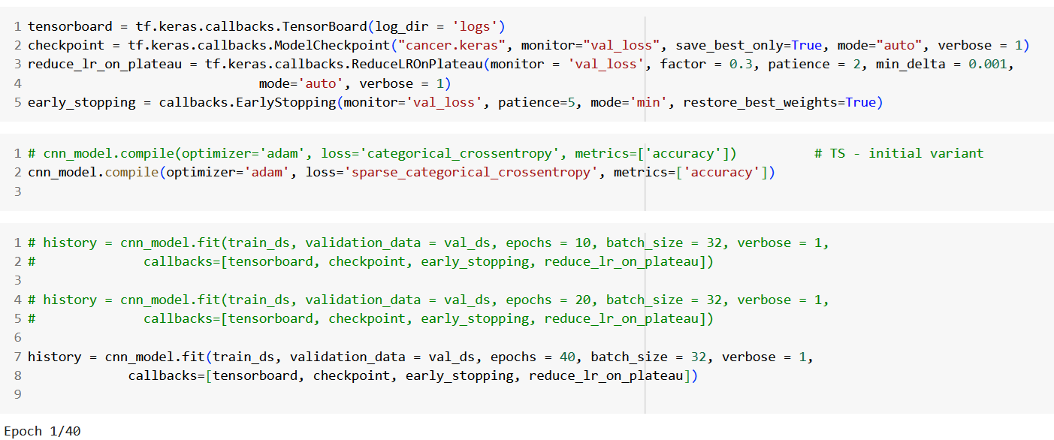

Slide 19
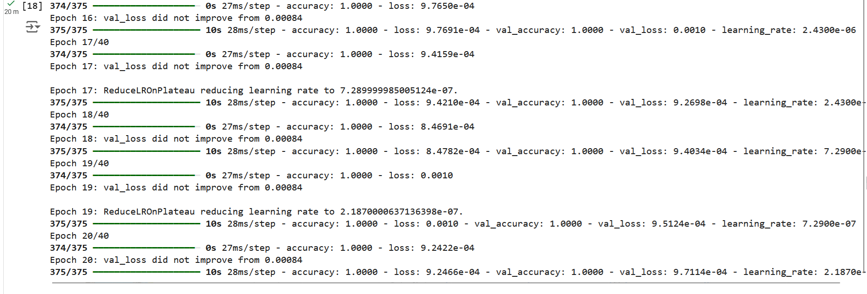

Slide 20
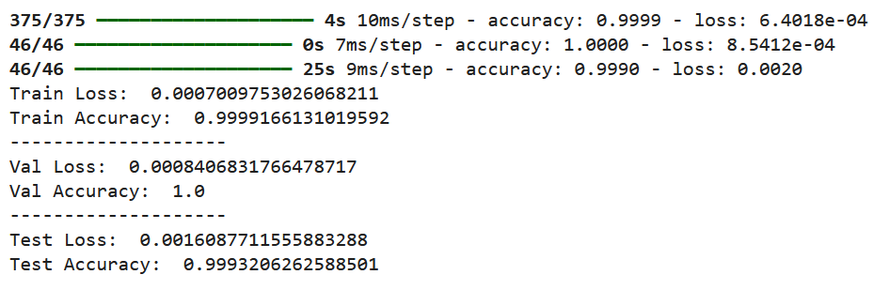
EVALUATION

Slide 21
MODEL PERFORMANCE

Slide 22
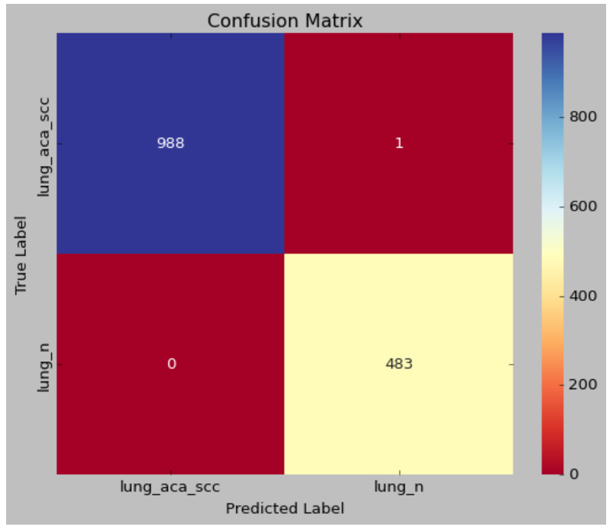
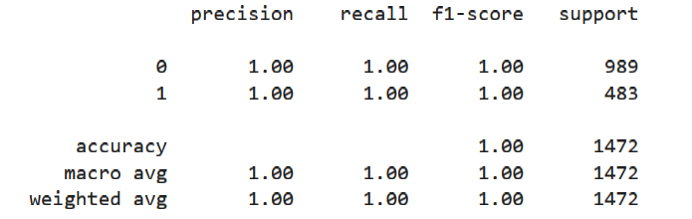
Confusion Matrix

Slide 23
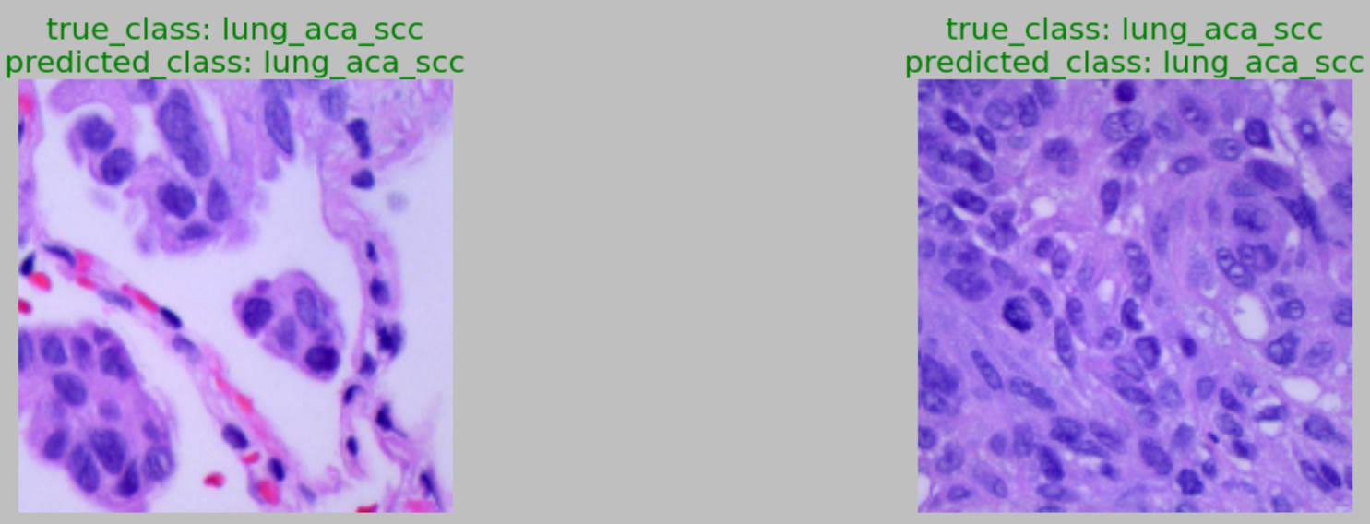
Predictions

Slide 24
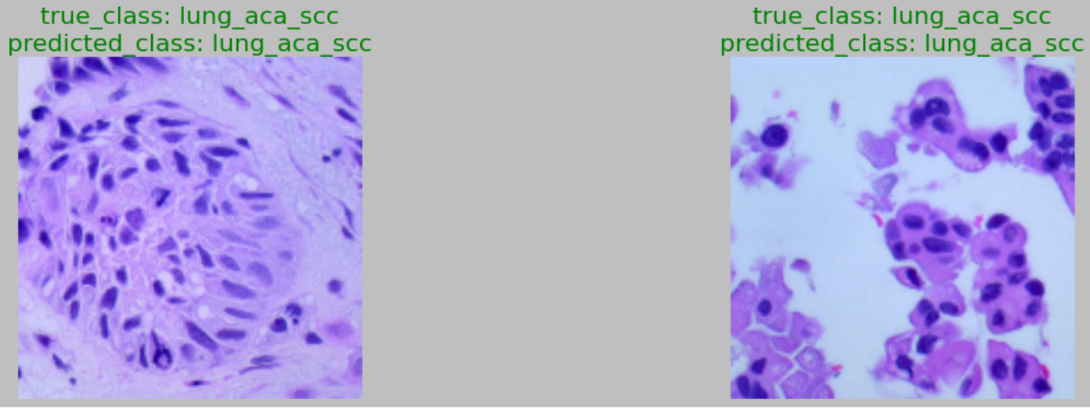
Predictions

Slide 25
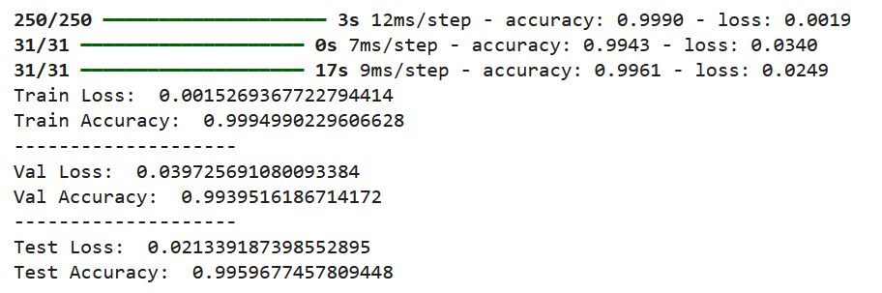
STRATEGY 2 - aca vs. scc

Slide 26
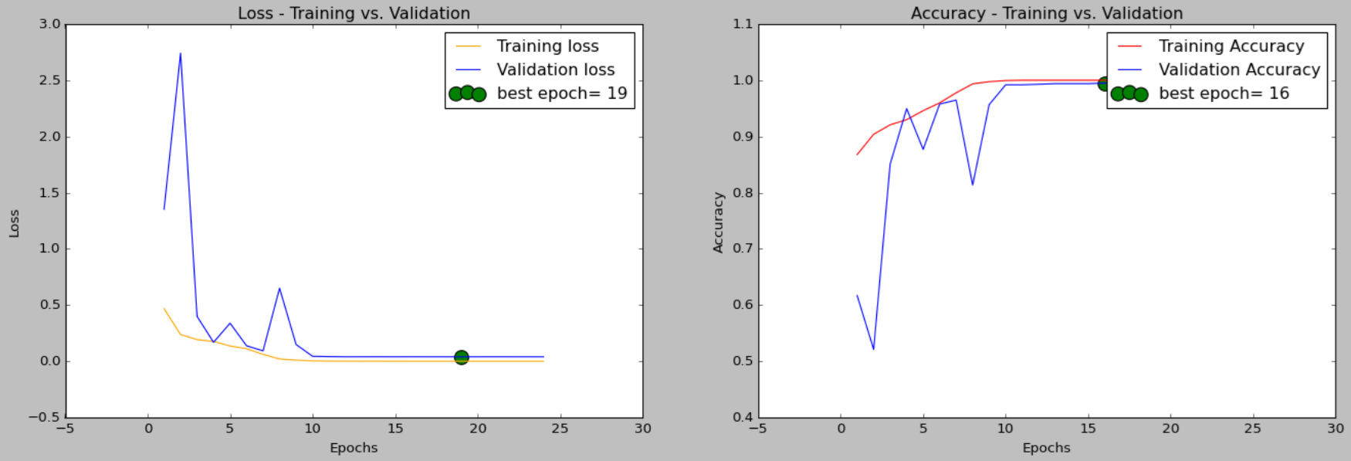

Slide 27
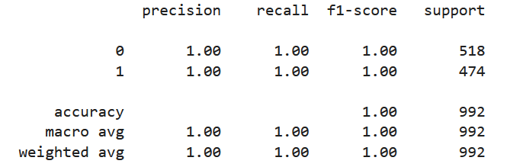
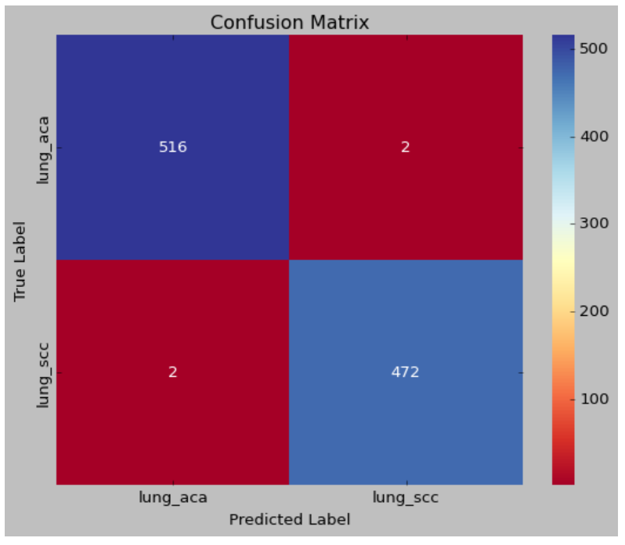

Slide 28
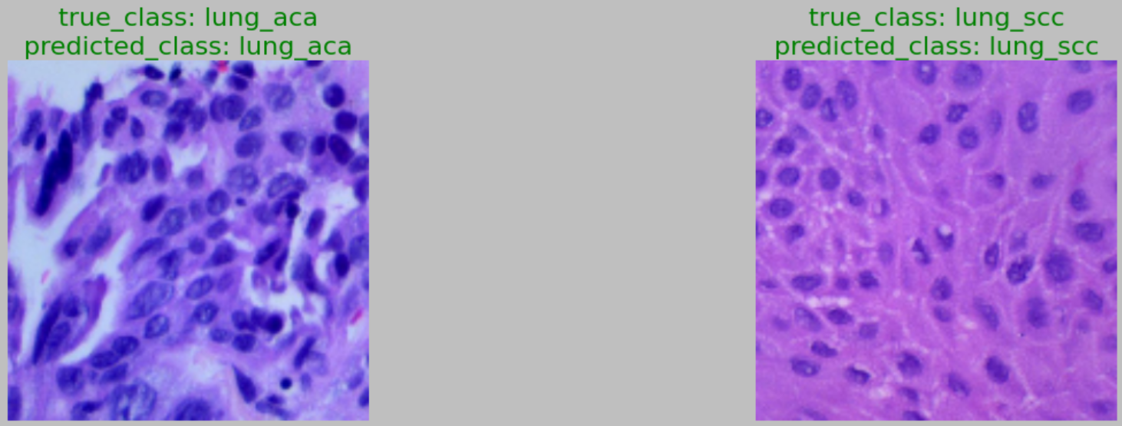

Slide 29
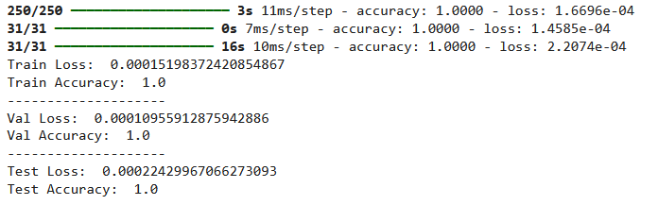
STRATEGY 3 - lung aca vs. n

Slide 30
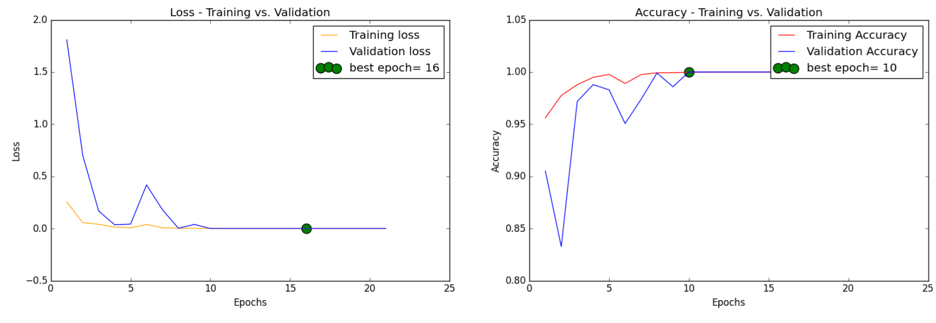

Slide 31
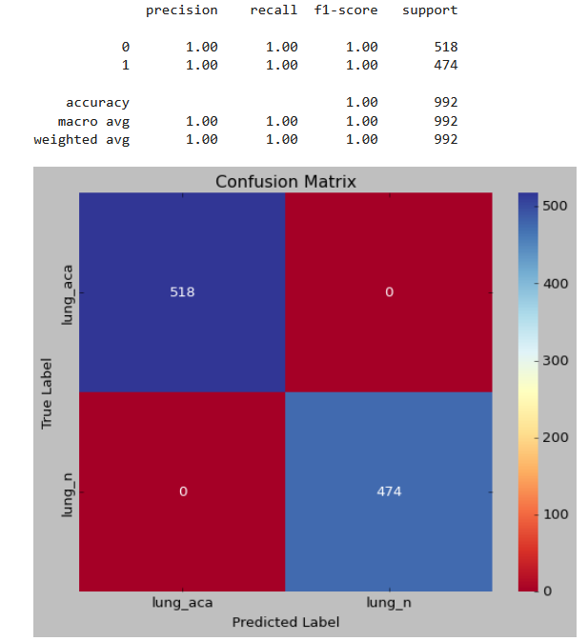

Slide 32
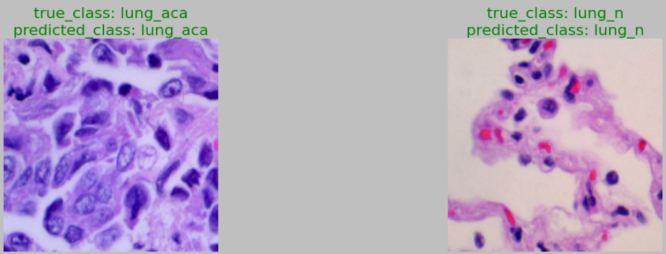

Slide 33
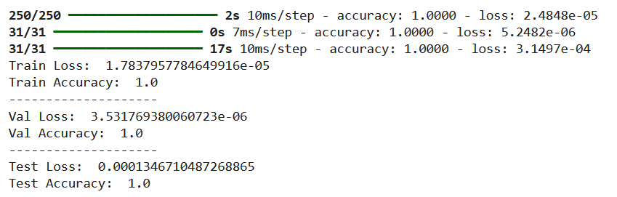
STRATEGY 4 - lung scc vs. n

Slide 34
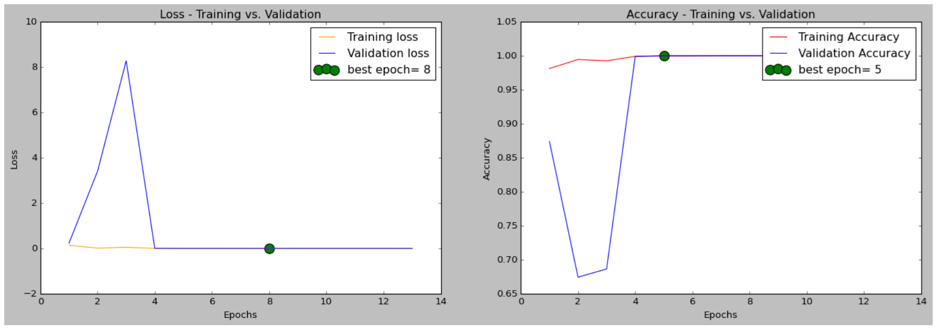

Slide 35
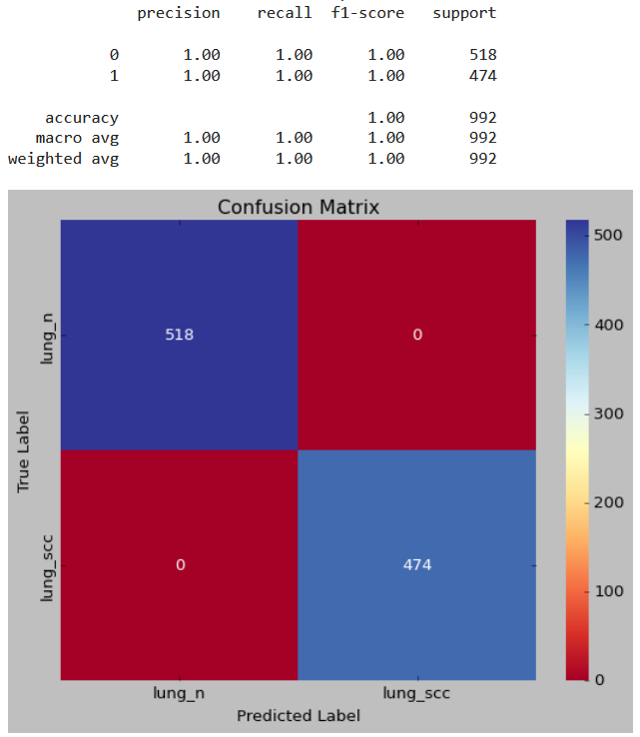

Slide 36
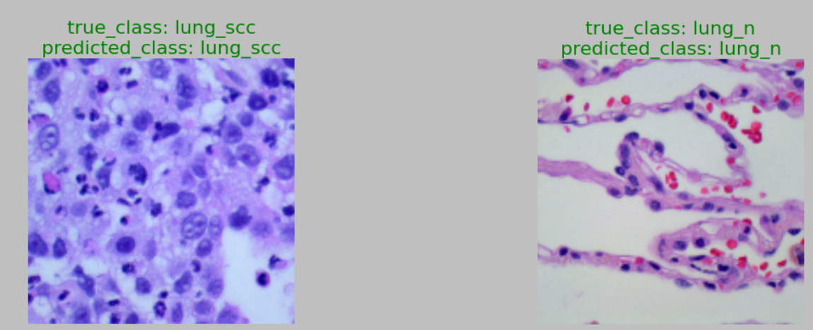

Slide 37
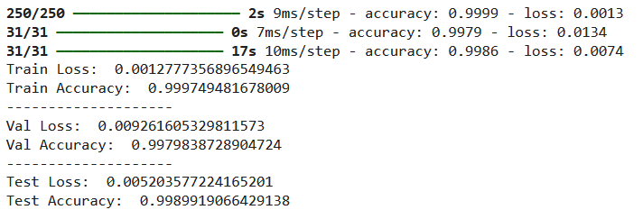
STRATEGY 5 - colon aca vs. n

Slide 38
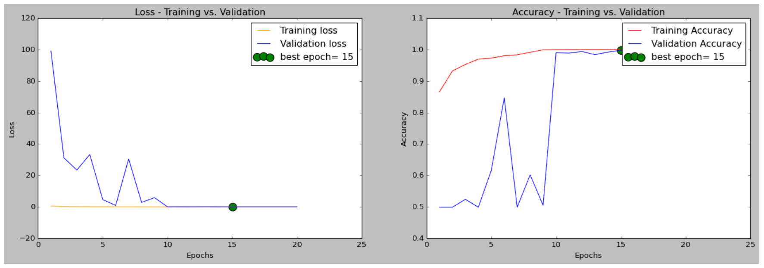

Slide 39
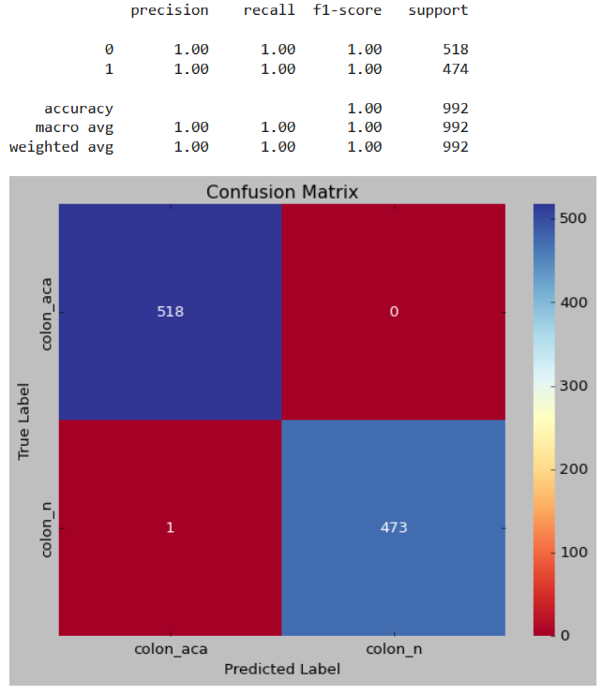

Slide 40
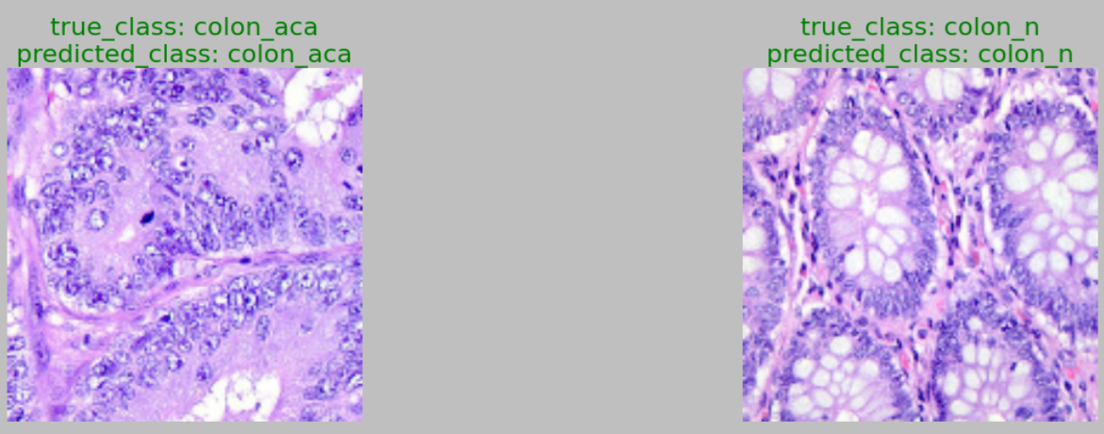

Slide 41

Time to rest :)

